Slide 1

Mathematics for Programming

Slide 2
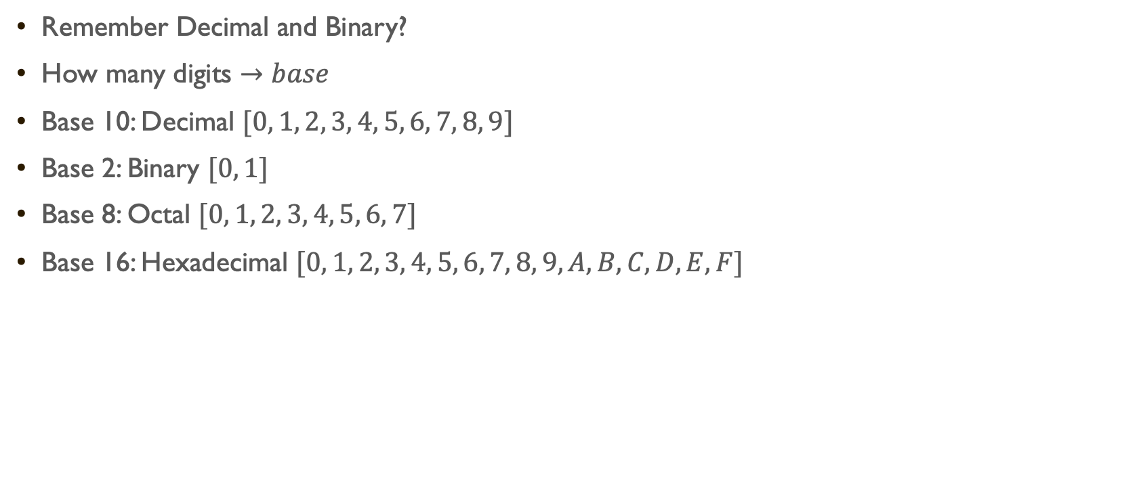
Number system
Remember Decimal and Binary?
How many digits $→base$
Base 10: Decimal $[0, 1, 2, 3, 4, 5, 6, 7, 8, 9]$
Base 2: Binary $[0, 1]$
Base 8: Octal $[0, 1, 2, 3, 4, 5, 6, 7]$
Base 16: Hexadecimal $[0, 1, 2, 3, 4, 5, 6, 7, 8, 9, A, B, C, D, E, F]$

Slide 3
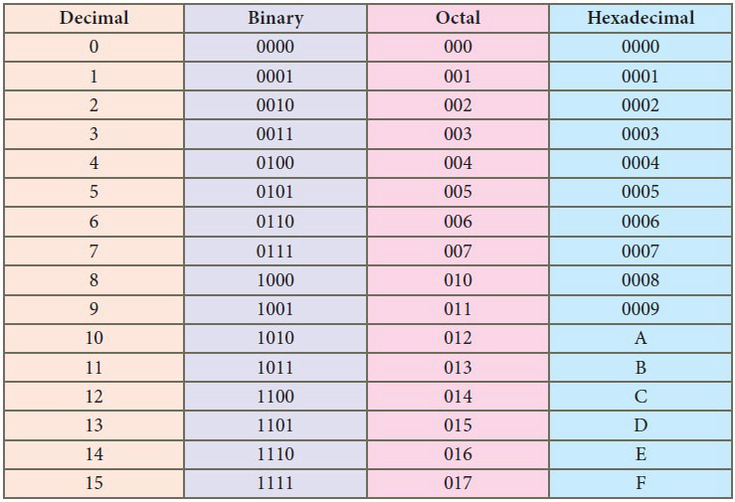

Slide 4
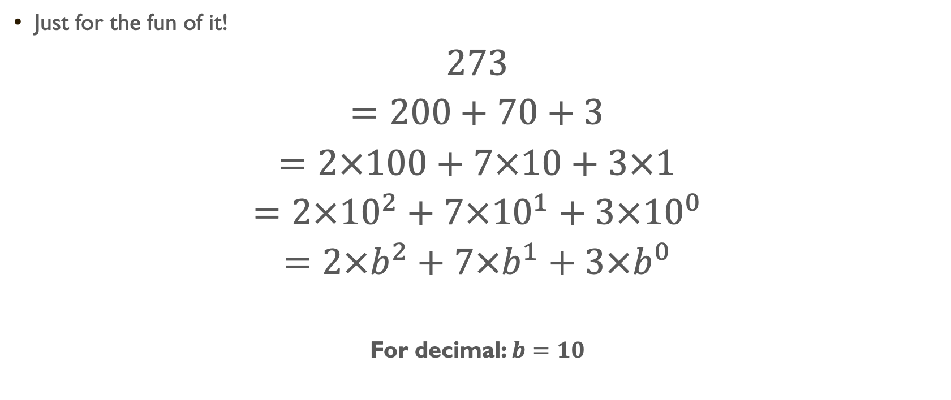
Convert DECIMAL to decimal
Just for the fun of it!
$$273$$
$$=200+70+3$$
$$=2×100+7×10+3×1$$
$$=2×{10}^{2}+7×{10}^{1}+3×{10}^{0}$$
$$=2×b^{2}+7×b^{1}+3×b^{0}$$
For decimal: $b=10$

Slide 5
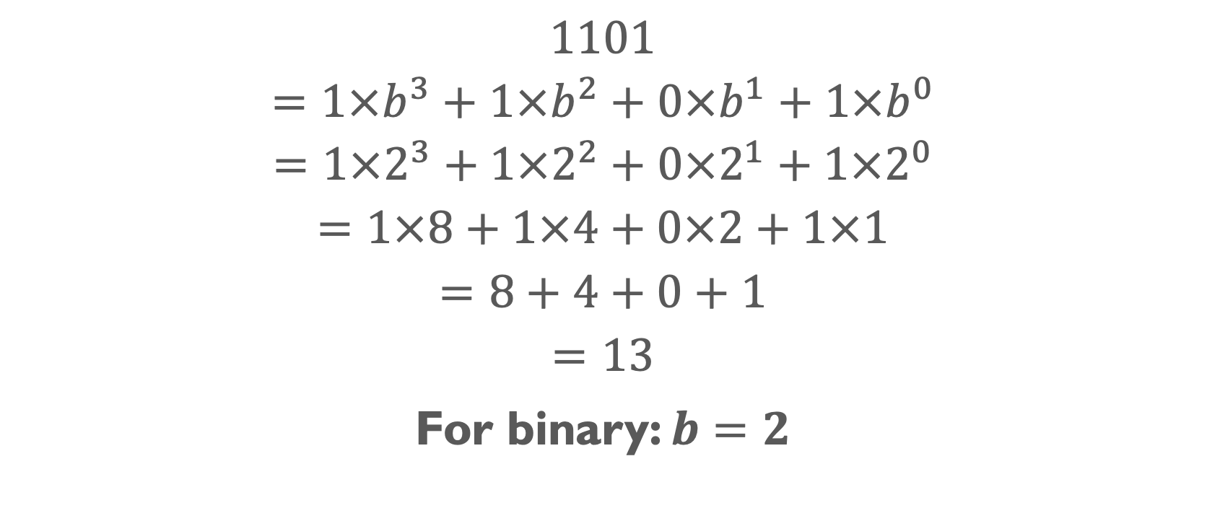
Convert Binary to decimal
$$1101$$
$$=1×b^{3}+1×b^{2}+0×b^{1}+1×b^{0}$$
$$=1×2^{3}+1×2^{2}+0×2^{1}+1×2^{0}$$
$$=1×8+1×4+0×2+1×1$$
$$=8+4+0+1$$
$$=13$$
For binary: $b=2$

Slide 6
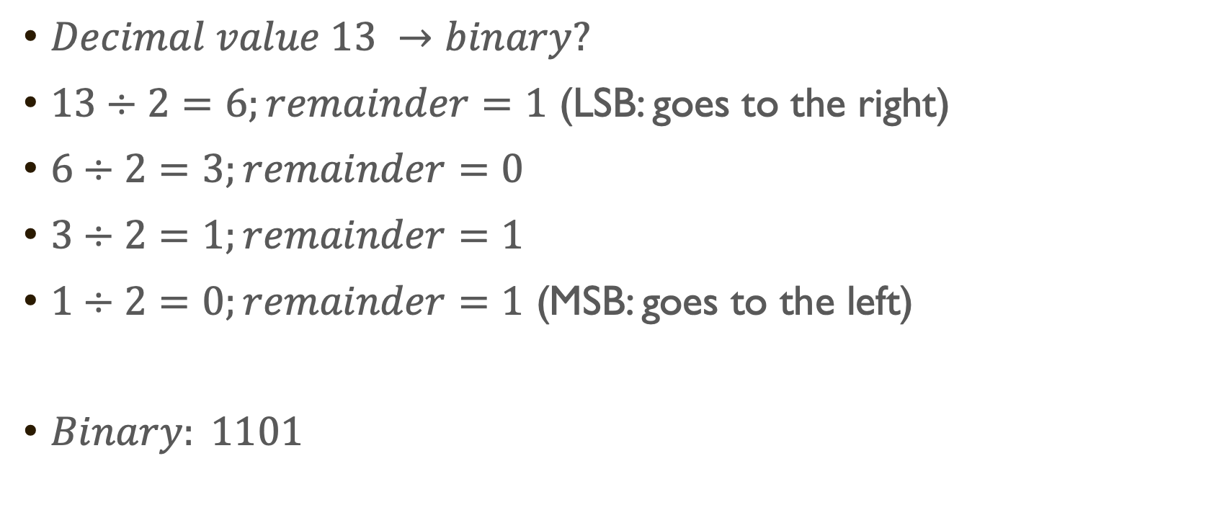
Convert Decimal to binary
$Decimal value 13 →binary?$
$13÷2=6;remainder=1$ (LSB: goes to the right)
$6÷2=3;remainder=0$
$3÷2=1;remainder=1$
$1÷2=0;remainder=1$ (MSB: goes to the left)
$Binary: 1101$

Slide 7
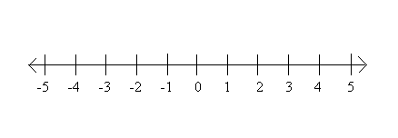






Types of numbers
$$Real number:any point on the number line$$
$$Positive number (right to the zero)$$
$$Negative number (left to the zero)$$
$$Non−negative number (Positive and zero)$$
$$Natural Numbers:\{1,2,3,…\}$$
$$Integers:\{…,−3, −2,−1,0,1,2,3,…\}$$
$$Whole Numbers:\{0,1,2,3,…\}$$
$Rational and Irrational numbers$

Slide 8
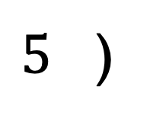
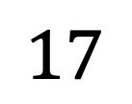
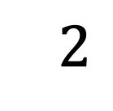
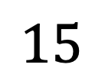
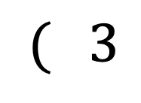
Let’s learn about division
Dividend / ভাজ্য
$5$ )
$$17$$
$$( 3$$
$$15$$
Quotient / ভাগফল
$$2$$
Divisor / ভাজক
Remainder / ভাগশেষ

Slide 9
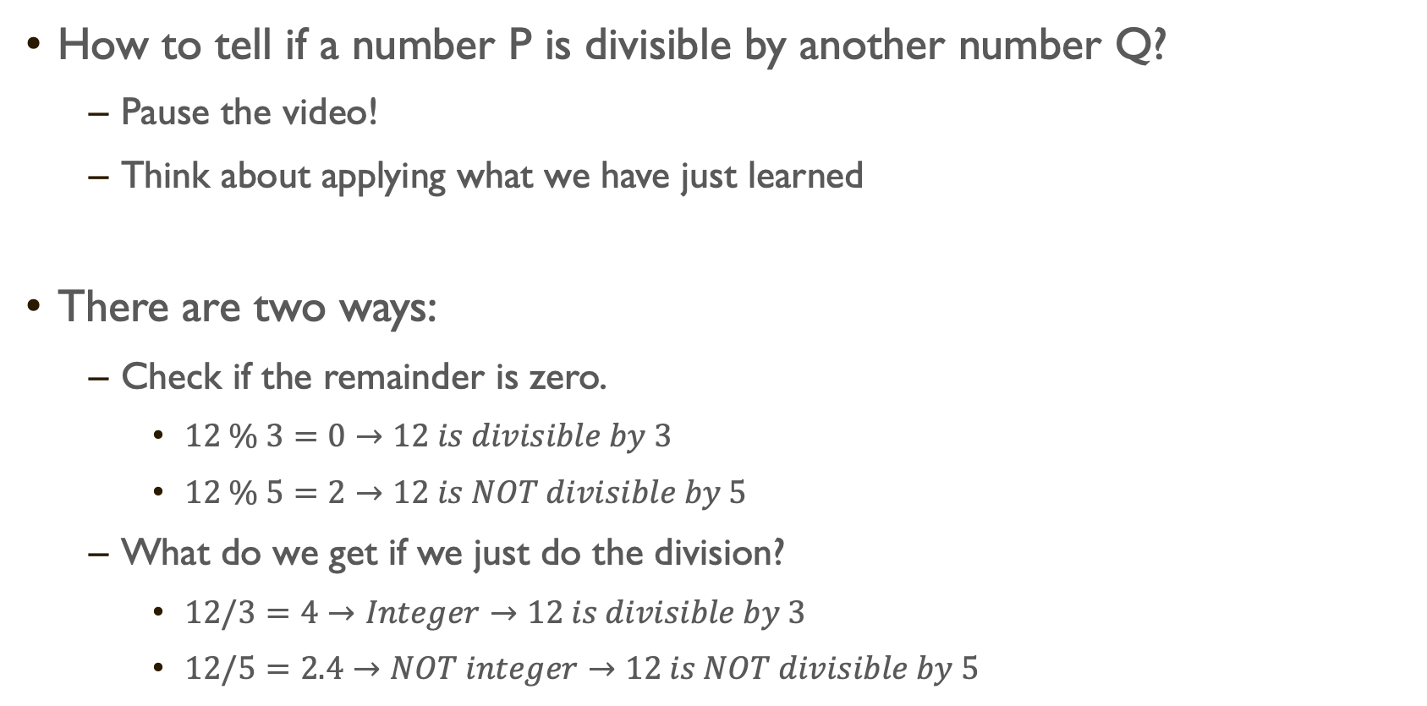
Divisibility check
How to tell if a number P is divisible by another number Q?
Pause the video!
Think about applying what we have just learned
There are two ways:
Check if the remainder is zero.
$12 \% 3=0→12 is divisible by 3$
$12 \% 5=2→12 is NOT divisible by 5$
What do we get if we just do the division?
$12/3=4→Integer→12 is divisible by 3$
$12/5=2.4→NOT integer→12 is NOT divisible by 5$

Slide 10
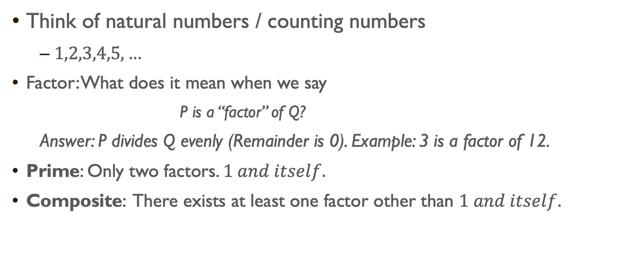
Prime and composite numbers
Think of natural numbers / counting numbers
$1,2,3,4,5,…$
Factor: What does it mean when we say
P is a “factor” of Q?
Answer: P divides Q evenly (Remainder is 0). Example: 3 is a factor of 12.
Prime: Only two factors. $1 and itself.$
Composite: There exists at least one factor other than $1 and itself.$

Slide 11
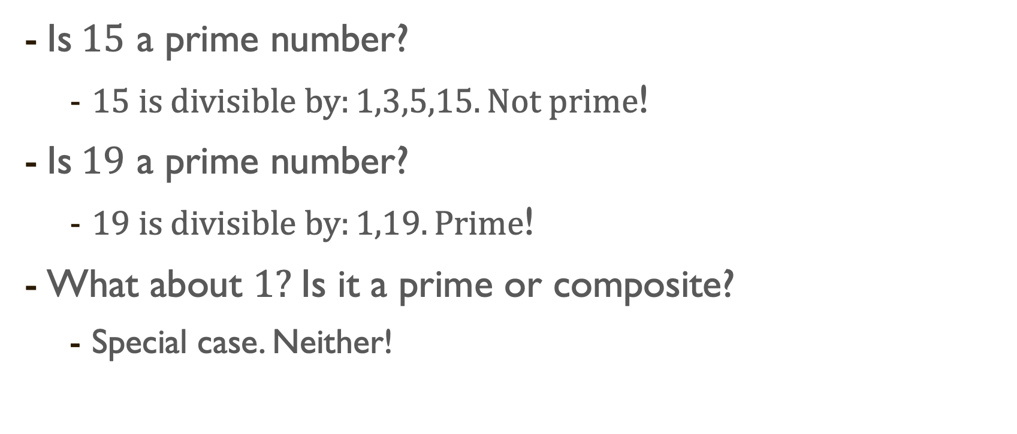
Prime and composite numbers
Is$15$ a prime number?
$15 is divisible by:1,3,5,15. Not prime$!
Is$19$ a prime number?
$19 is divisible by:1,19. Prime$!
What about $1?$Is it a prime or composite?
Special case. Neither!

Slide 12
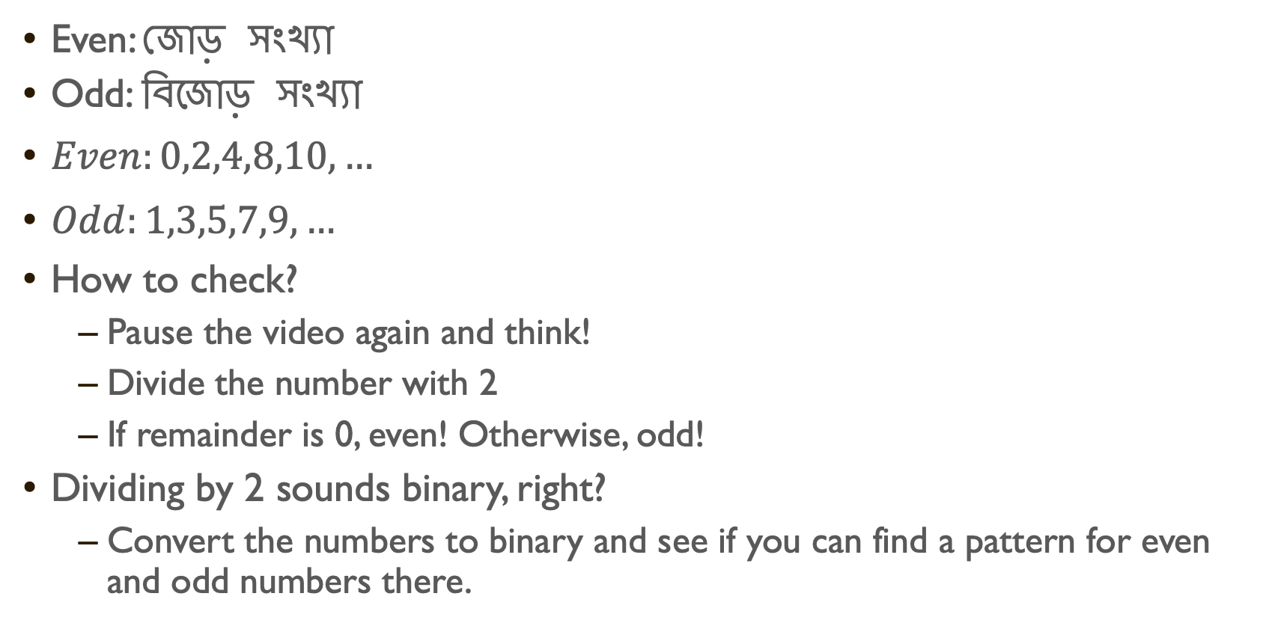
Even and odd numbers
Even: জোড় সংখ্যা
Odd: বিজোড় সংখ্যা
$Even:0,2,4,8,10,…$
$Odd:1,3,5,7,9,…$
How to check?
Pause the video again and think!
Divide the number with 2
If remainder is 0, even! Otherwise, odd!
Dividing by 2 sounds binary, right?
Convert the numbers to binary and see if you can find a pattern for even and odd numbers there.

Slide 13
Summary
We are more comfortable with the number systems
Especially binary numbers!
Learned the types of numbers and how they are related
Reviewed the division process and terminologies.
Divisibility check and its use
Prime numbers and how to detect them when you see one!
Even odd numbers, with a brain teaser!

Slide 14
NEXT

Slide 15
NEXT

Slide 16
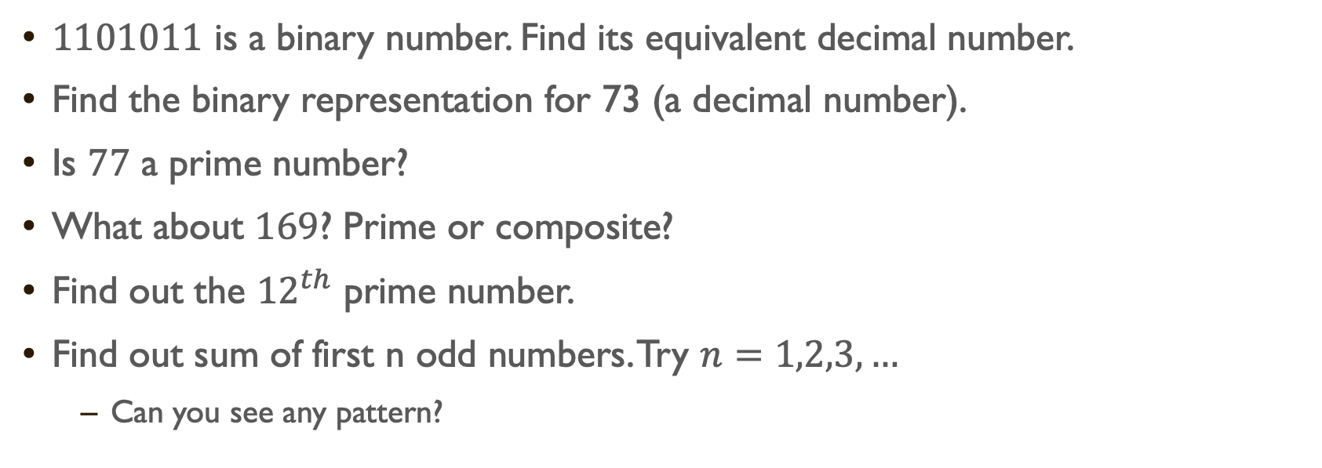
Practice Day
$1101011$ is a binary number. Find its equivalent decimal number.
Find the binary representation for 73 (a decimal number).
Is $77$ a prime number?
What about $169$? Prime or composite?
Find out the ${12}^{th}$ prime number.
Find out sum of first n odd numbers. Try $n=1,2,3,…$
Can you see any pattern?

